Slide 1
Basics of Electronics Engineering
Presented By:
Dr. Gurjinder Singh
Chitkara University, Punjab, India

Slide 2
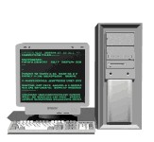
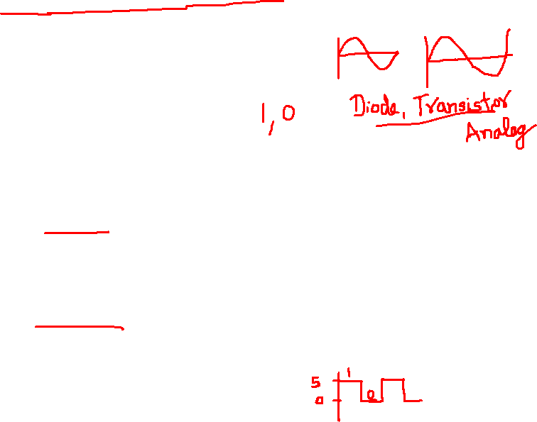
Why was digital electronics needed??
□ Most analog systems were less accurate, and were slow in computation and performance.
Digital system have the ability to work faster than analog equivalents, and can operate on very high frequencies too ! ! ! ! !
It was much economical than analog methodologies as the performance was faster !

Slide 3
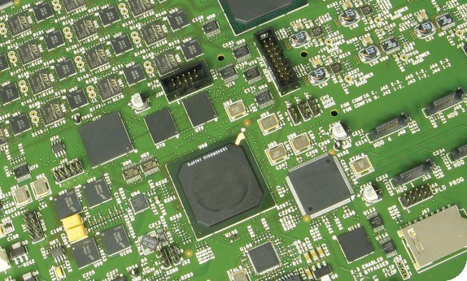

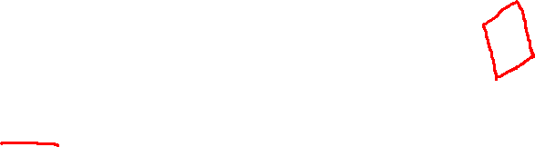
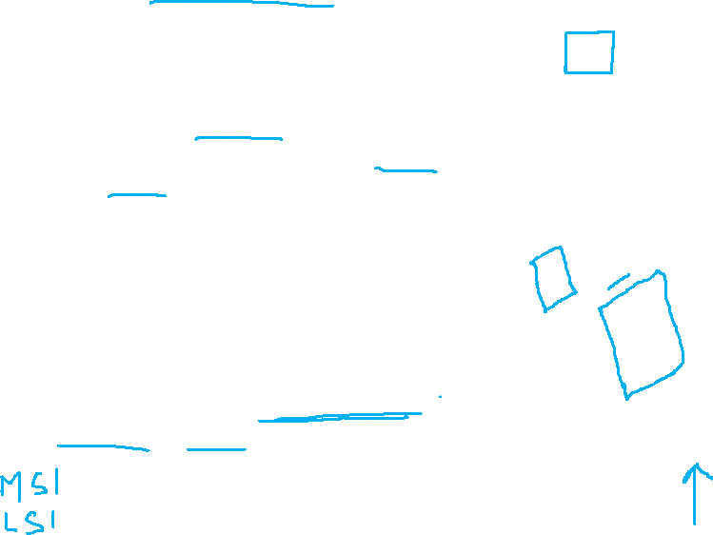
What are Integrated Circuits (IC’s) ???
□ IC’s are the micro circuits which are fabricated on a very small silicon wafers (chip) at which various components like BJT, CMOS etc. are mounted up to make a wholesome functional unit.
□ These days, various types of circuit integrations are possible at large extent, i.e. small scale, large scale, and very large scale integration (VLSI).

Slide 4
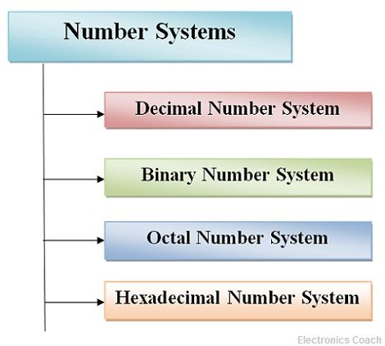
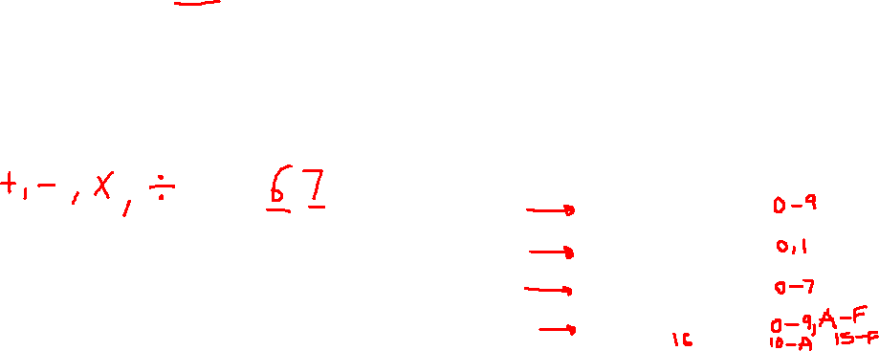
Number System
When we type some letters or words, the computer translates them in numbers as computers can understand only numbers.
A computer can understand the positional number system where there are only a few symbols called digits and these symbols represent different values depending on the position they occupy in the number.
The value of each digit in a number can be determined using −
The digit
The position of the digit in the number
The base of the number system (where the base is defined as the total number of digits available in the number system)

Slide 5
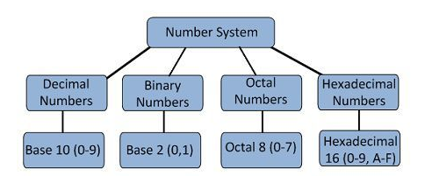

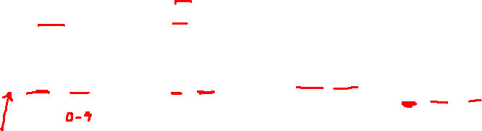
Different Types of Number System

Slide 6
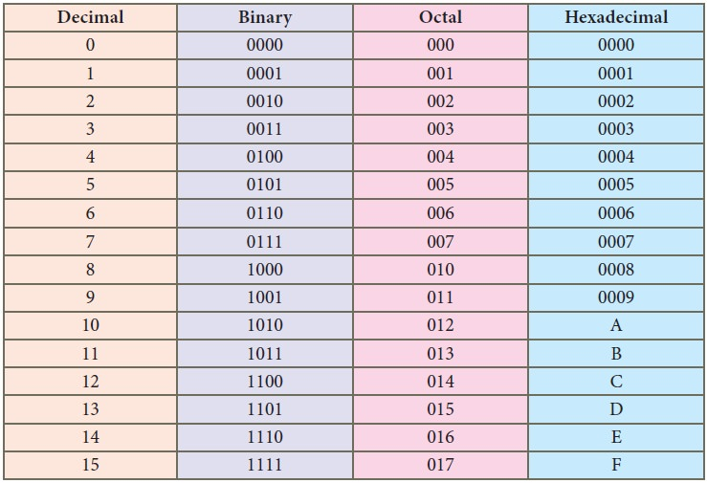
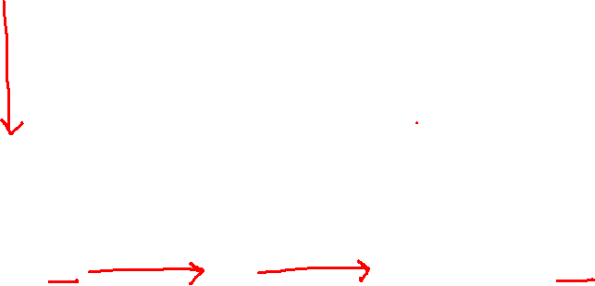
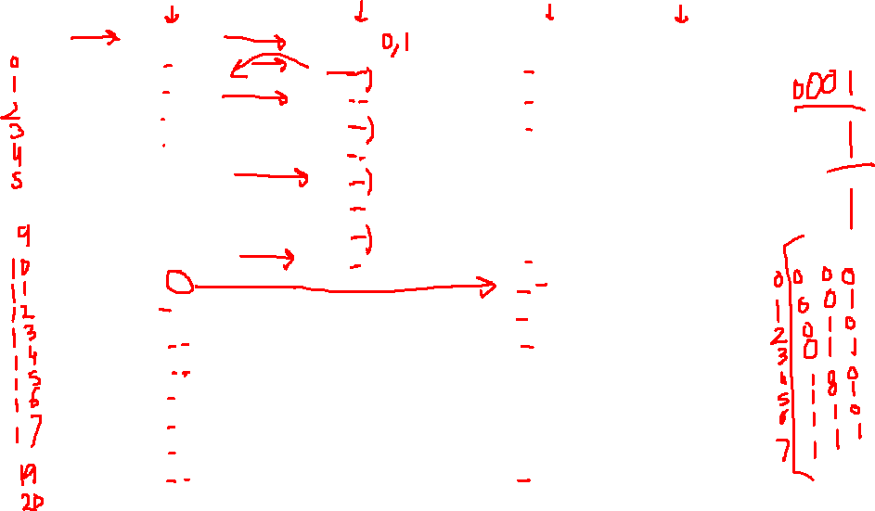
Comparison between Different Number System

Slide 7
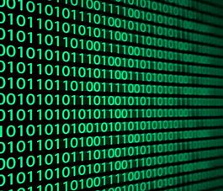
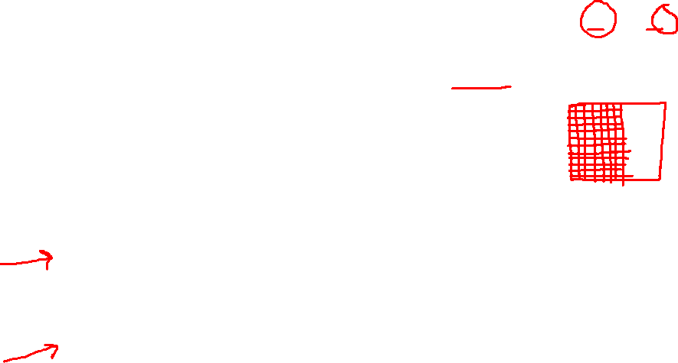
Binary Number System
The binary number system is a numbering system that represents numeric values using two unique digits (0 and 1). Most computing devices use binary numbering to represent electronic circuit voltage state, (i.e., on/off switch), which considers 0 voltage input as off and 1 input as on.

Slide 8
Binary Number Systems
All the information in the digital computer is represented as bit patterns
What is a bit pattern?
01010101 is called as the bit pattern
01010101
This is one bit

Slide 9
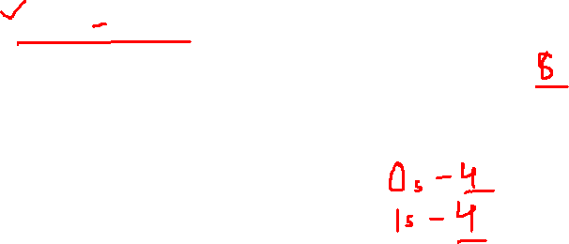
Binary Number Systems
Look at this bit pattern
0101 0101
How many bits are present ?
Count the number of ones and the zeros in the above pattern

Slide 10
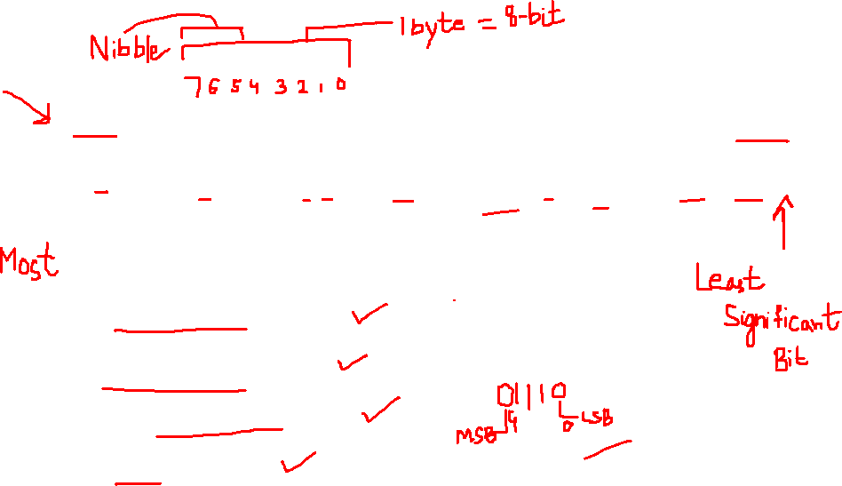
Binary Number Systems
0101 0101 in the digital computer
Bit7 | Bit 6 | Bit 5 | Bit 4 | Bit 3 | Bit 2 | Bit 1 | Bit 0
0 (MSB) | 1 | 0 | 1 | 0 | 1 | 0 | 1 (LSB)
There are 8 bits in the above table
Group of 4 bits= 1 Nibble
Group of 8 bits= 1 Byte
Group of 16 bits = 1 Word
2 Bytes = 1 Word

Slide 11
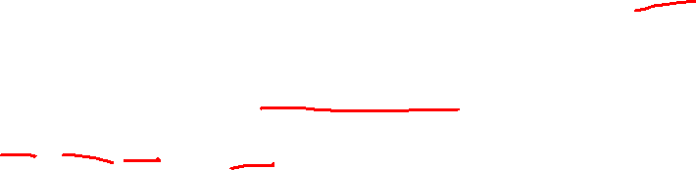



Binary Number Systems
A single bit can represent two states:0 1
Therefore, if you take two bits, you can use them to represent four unique states:
00, 01, 10, & 11
And, if you have three bits, then you can use them to represent eight unique states:
000, 001, 010, 011, 100, 101, 110, & 111

Slide 12


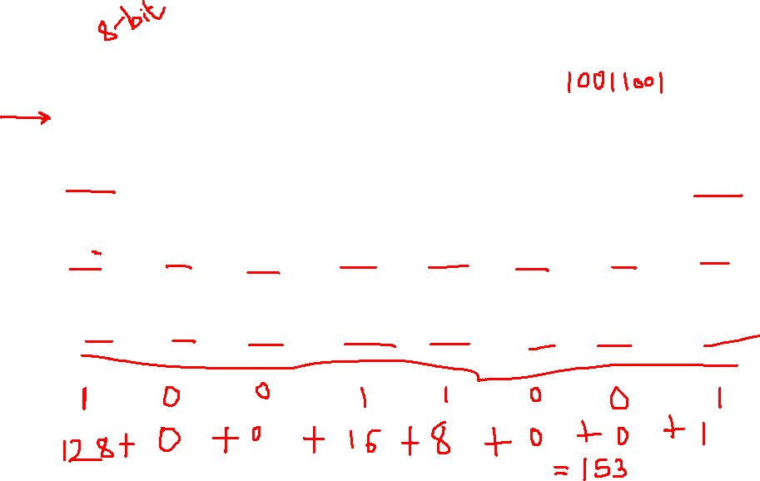

Binary Number Systems
Bit positions and their values
Bit7 | Bit 6 | Bit 5 | Bit 4 | Bit 3 | Bit 2 | Bit 1 | Bit 0
₂7 | ₂6 | ₂5 | ₂4 | ₂3 | ₂2 | ₂1 | ₂0
128 | 64 | 32 | 16 | 8 | 4 | 2 | 1

Slide 13
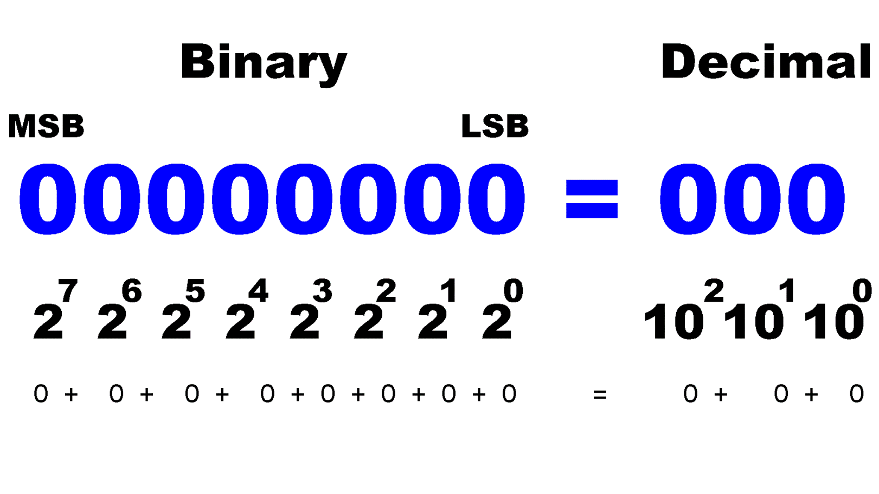
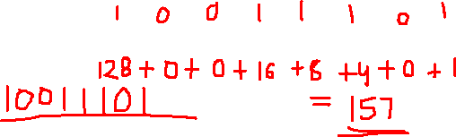
Binary Number Systems
Only two levels
Easy to represent binary values electrically
Can be implemented using circuits
Create the building blocks of modern computers

Slide 14
Advantages- Binary Numbers
Binary is extremely simple to implement. Any system that has an "on" and "off" or "high" and "low" state can be used to encode and/or manipulate data.
Binary is the lowest "base" possible (base 2) and hence any higher counting system can be easily encoded (e.g. decimal, octal, hexadecimal, etc.).
Binary would be the most effective way to attempt to communicate with any type of alien civilization. Just as "math" is a type of universal language (any alien civilization would understand a sequence of prime numbers, for example) binary is a universal alphabet.

Slide 15

Convert Decimal to Binary
For Each Digit Position
Divide decimal number by the base (e.g. 2)
The remainder is the lowest-order digit
Repeat first two steps until no divisor remains.

Slide 16
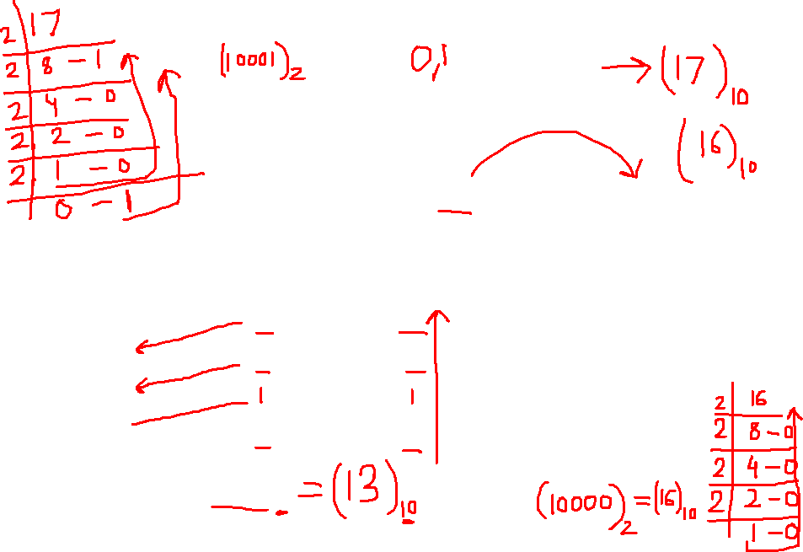
Convert Decimal to Binary
Example: Convert Decimal 13 (13 ₁₀) to Binary : Repeated division by 2 (till quotient is zero)
Divide-by -2 | Quotient | Remainder | Binary Bits
13/2 6 / 2 3 / 2 1 / 2 | 6 3 1 0 | 1 0 1 1 | Bit 0 = 1 Bit 1 = 0 Bit 3 = 1 Bit 4 = 1
Answer = 1101₂

Slide 17
Convert Decimal to Binary (Fraction)
Example: Convert Decimal (.625 ₁₀) to Binary : Repeated multiplication by 2
Mult-by -2 | Ans | Carry | Binary Bits
.625 * 2 .250 * 2 0.50 * 2 0 * 2 | 1.250 0.50 1.00 0 | 1 0 1 - | 1 0 1 ---
Answer = .101₂

Slide 18
Convert Binary to Decimal Example: Convert 1101₂
Multiply each 1 bit by the appropriate power of 2 and add them together.
0
Bit 3
1
Bit 2
1
Bit 1
1
Bit 0

Slide 19
Convert Binary to Decimal Example: Convert 1101₂
Bit7 | Bit 6 | Bit 5 | Bit 4 | Bit 3 | Bit 2 | Bit 1 | Bit 0
₂7 | ₂6 | ₂5 | ₂4 | ₂3 | ₂2 | ₂1 | ₂0
128 | 64 | 32 | 16 | 8 | 4 | 2 | 1
 |  |  |  | 1 | 1 | 0 | 1
Multiply with these values
8 x 1 + 4 x 1 + 2 x 0 + 1x 1 = 8 + 4 + 0 + 1
= 13

Slide 20
Convert Binary to Decimal (Fraction) Example: Convert .1101₂
Bit -1 | Bit -2 | Bit -3 | Bit -4 | Bit -5 | Bit -6
₂-1 | ₂-2 | ₂-3 | ₂-4 | ₂-5 | ₂-6
0.5 | 0.25 | 0.125 | 0.062 | 1/32 | 1/64
1 | 1 | 0 | 1
Multiply with these values
0.5 x 1 + 0.25 x 1 + 0.125 x 0 + 0.062 x 1 = 0.5 + 0.25 + 0 + 0.062
= 0.8125

Slide 21
Binary Number Systems
Example: 1011₂ or 1011 _{B}
= 1 x 2³ + 0 x 2² + 1 x 2¹ + 1 x 2⁰
= 8 + 0 + 2 +1
= 11₁₀

Slide 22
Binary Number Systems
Example: 10110₂ or 10110 _{B}
1 x 2⁴+0 x 2³ + 1 x 2² + 1 x 2¹ + 0 x 2⁰
= 16 + 0 + 4 +2+0
= 22₁₀

Slide 23
Other Number Systems
Octal and hex are a convenient way to represent binary numbers, as used by computers.
Computer mechanics often need to write out binary quantities, but in practice writing out a binary number such as

Slide 24
Other Number Systems
1001001101010001 is tedious, and prone to errors.
Therefore, binary quantities are written in a base-8 ("octal") or, much more commonly, a base-16 ("hexadecimal" or "hex") number format.

Slide 25
Octal Number Systems
Base = 8 or ‘o’ or ‘Oct’
8 symbols: { 0, 1, 2, 3, 4, 5, 6, 7}
Example
123, 567, 7654 etc
987 This is incorrect why?
How to represent a Decimal Number using a Octal Number System ?

Slide 26
Octal Number Systems (Decimal to Octal)
Repeated Division by 8
Example
213₁₀ = ( )₈ ?
Divide-by -8 | Quotient | Remainder | Octal digit
213 / 8 26 / 8 3 / 8 | 26 3 0 | 5 2 3 | Lower digit = 5 Second digit =2 Third digit =3
Answer = 325₈

Slide 27
Octal Number Systems (Decimal to Octal)
Convert 393 to octal
Divide-by -8 | Quotient | Remainder | Octal digit
393 / 8 49 / 8 6 / 8 | 49 6 0 | 1 1 6 | Lower digit = 1 Second digit =1 Third digit =6
Answer = 611₈

Slide 28
Convert Decimal to Octal (Fraction)
Example: Convert Decimal (.625 ₁₀) to Octal : Repeated multiplication by 8
Mult-by -8 | Ans | Carry | Number
.625 * 8 .00 * 8 | 5.00 00 | 5 0
Answer = .50₈

Slide 29
Octal Number Systems (Octal to Decimal)
How to convert 325₈ back to Decimal ?
Use this table and multiply the digits with the position values
Digit 8 | Digit 7 | Digit 6 | Digit 5 | Digit 4 | Digit 3 | Digit 2 | Digit 1
₈7 | ₈6 | ₈5 | ₈4 | ₈3 | ₈2 | ₈1 | ₈0
…… | …… | 32768 | 4096 | 512 | 64 | 8 | 1

Slide 30
Octal Number Systems (Octal to Decimal Example)
How to convert 325₈ back to Decimal ?
Consider the above number
3 2 5 ₍₈₎
Digit 1
Digit 3
Digit 2
3 x 8² + 2 x 8¹ + 5 x 8⁰ = 3 x 64 + 2 x 8 + 5 x 1
= 192 +16 + 5
= 213

Slide 31
Octal Number Systems (Octal to Decimal Example)
Example Convert 611₈
Consider the above number
6 1 1 ₍₈₎
Digit 1
Digit 3
Digit 2
6 x 8² + 1 x 8¹ + 1 x 8⁰ = 6 x 64 + 1 x 8 + 1 x 1
= 384 + 8 + 1
= 393

Slide 32
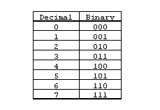
Octal Number Systems (Octal to Binary)
Write in combination of 2 bits
6 1 1 ₍₈₎
110
001
001
= 110 001 001

Slide 33
Octal Number Systems (Binary to Octal)
Reverse the procedure
11011010101
Make combination of three bits, starting
From LSB
11 011 010 101
3
3
2
5
Answer :- 3325 ₍₈₎

Slide 34
Hexadecimal Number Systems
Base = 16 or ‘H’ or ‘Hex’
16 symbols: { 0, 1, 2, 3, 4, 5, 6, 7,8,9 }
{ 10=A, 11=B, 12=C, 13=D, 14=E, 15= F}

Slide 35
Hexadecimal Number Systems
{0,1,2,3,4,5,6,7,8,9,A,B,C,D,E,F} It uses 6
Letters !
Example AB12, 876F, FFFF etc
How to represent a Decimal Number using a Hexadecimal Number System ?

Slide 36
Hex Number Systems (Decimal to Hexadecimal)
Repeated Division by 16
Example
213₁₀ = ( )₁₆ ?
Divide-by -16 | Quotient | Remainder | Hex digit
213 / 16 13 / 16 | 13 0 | 5 13 | Lower digit = 5 Second digit =D
Answer = D5₁₆

Slide 37
Hex Number Systems (Hexadecimal to Decimal)
How to convert D5₁₆ back to Decimal ?
Use this table and multiply the digits with the position values
Digit 8 | Digit 7 | Digit 6 | Digit 5 | Digit 4 | Digit 3 | Digit 2 | Digit 1
16⁷ | 16⁶ | 16⁵ | 16⁴ | 16³ | 16² | 16¹ | 16⁰
…… | …… | ….. | …… | 4096 | 256 | 16 | 1

Slide 38
Hex Number Systems
How to convert D5₁₆ back to Decimal ?
Consider the above number
^{D 5} (16)
Digit 1
Digit 2
D x 16¹ + 5 x 16⁰ = 13 x 16 + 5 x 1
= 208 + 5
= 213

Slide 39
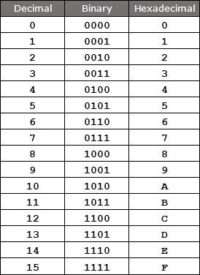
Binary to Hexadecimal
Make combination of 4 bits
11011010101
Make combination of Four bits, starting
From LSB
110 1101 0101
6
D
5
Answer : 6D5 ₍₁₆₎

Slide 40
Hexadecimal to Binary
Reverse the procedure and write
Equivalent bit in combination of 4 bits
2A6 ₍₁₆₎
2 A 6
0010
1010
0110
Answer :- 001010100110 ₍₂₎

Slide 41
Octal to Hexadecimal
Convert Octal into Binary
Make combination of 4 bits
Write the equivalent Hexadecimal Number
Convert 24 ₍₈₎ into ? ₍₁₆₎
24 ₍₈₎ to Binary equivalent is
010
100
= 010100
Now make combinations of 4 bits
01 0100
1
4
Answer : 14 ₍₁₆₎

Slide 42
Hexadecimal to Octal (Reverse the procedure)
Convert Hexadecimal into Binary
Make combination of 3 bits
Write the equivalent Octal Number
Convert 2A6 ₍₁₆₎ into ? ₍₈₎
2 A 6 to Binary equivalent
0110
= 001010100110
0010
1010
Now make combinations of 3 bits
001 010 100 110
1
2
4
6
Answer :- 1246 ₍₈₎

Slide 43
Summary
Decimal to any format :- Divide by the base, 2 for Binary, 8 for Octal and 16 for Hexa
Any format to Decimal :- Multiply by powers of base
Binary to Decimal ₂3 ₂2 ₂1 ₂0
Octal to Decimal ₈3 ₈2 ₈1 ₈0
Hexa to Decimal ₁₆3 ₁₆2 ₁₆1 ₁₆0
Binary to Octal :- Combination of 3 bits
Octal to Binary :- Each digit into 3 bits
Binary to Hexa :- Combination of 4 bits
Hexa to Binary :- Each digit into 4 bits
Octal to Hexadecimal :- Octal to Binary to Hexadecimal
Hexadecimal to Octal :- Hexadecimal to Binary to Octal

Slide 44
Remember the Binary Table

Slide 45
Thank You

